Slide 1
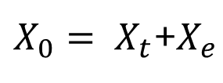
Chapter 5. Reliability: Conceptual Basis
Reliability refers to consistency of scores
Random errors vs. systematic errors
random errors: lucky guesses, missed answers, sickness, careless mistakes, etc.
Consistent or systematic errors
Spearman (1903, 1913) in trying to explain fallible measures, laid the foundation for the classical true-score model:
Individual’s observed test score -
Individual’s true score -
Error (random) affecting the individual’s responses -
$X_{0}= X_{t}$+$X_{e}$

Slide 2
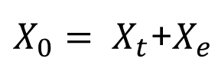
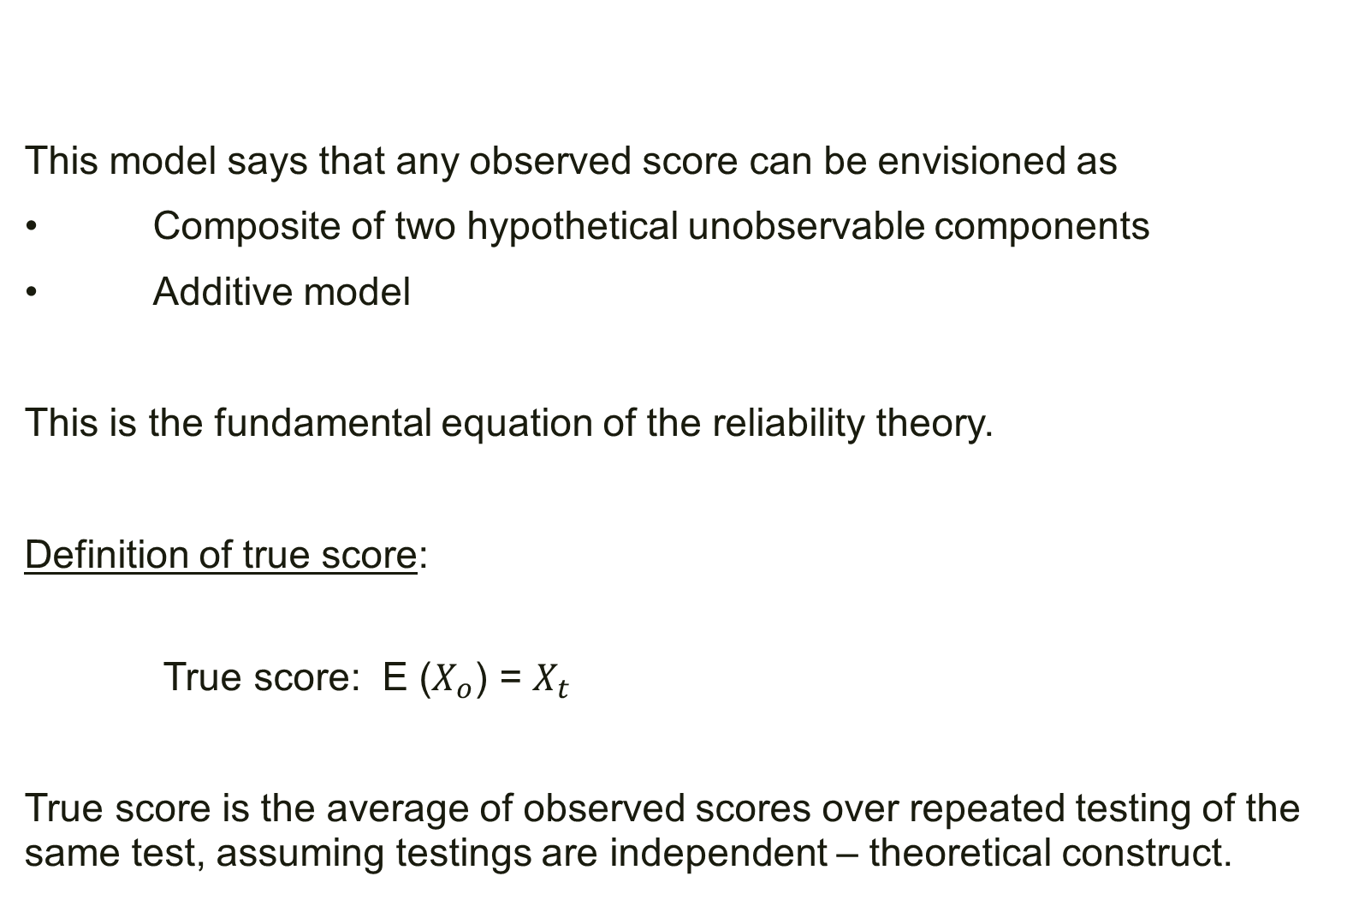
This model says that any observed score can be envisioned as
• Composite of two hypothetical unobservable components
• Additive model
This is the fundamental equation of the reliability theory.
Definition of true score:
True score: E ($X_{o}$) = $X_{t}$
True score is the average of observed scores over repeated testing of the same test, assuming testings are independent – theoretical construct.
$X_{0}= X_{t}$+$X_{e}$

Slide 3
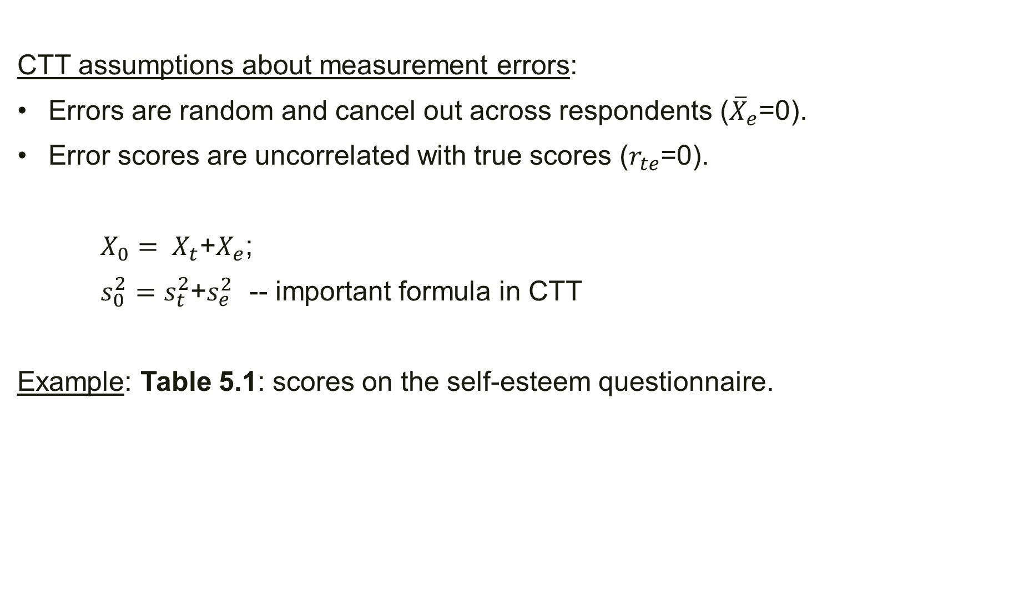
CTT assumptions about measurement errors:
Errors are random and cancel out across respondents (${\overline{X}}_{e}$=0).
Error scores are uncorrelated with true scores ($r_{te}$=0).
$X_{0}= X_{t}$+$X_{e}$;
$s_{0}^{2}=s_{t}^{2}$+$s_{e}^{2}$ -- important formula in CTT
Example: Table 5.1: scores on the self-esteem questionnaire.

Slide 4
Conceptual meaning of Reliability
The extent to which differences in respondents’ observed scores can be attributed to differences in their true scores.
The extent to which observed scores differences are consistent with true score differences among respondents.
Variability in observed scores is a reflection of variability in trues scores.
The extent to which errors contribute to differences in observed scores.
Correlation between observed scores and true scores.
There is no such thing as a perfectly reliable test.

Slide 5
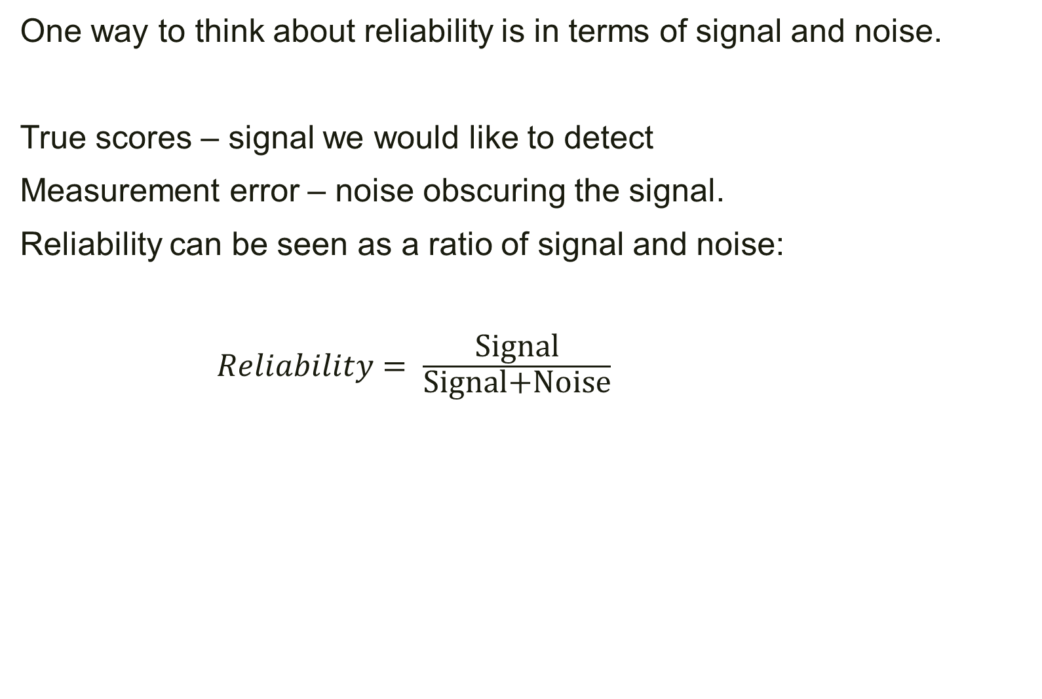
One way to think about reliability is in terms of signal and noise.
True scores – signal we would like to detect
Measurement error – noise obscuring the signal.
Reliability can be seen as a ratio of signal and noise:
$Reliability= \frac{\text{Signal}}{\text{Signal}\text{+}\text{Noise}}$

Slide 6
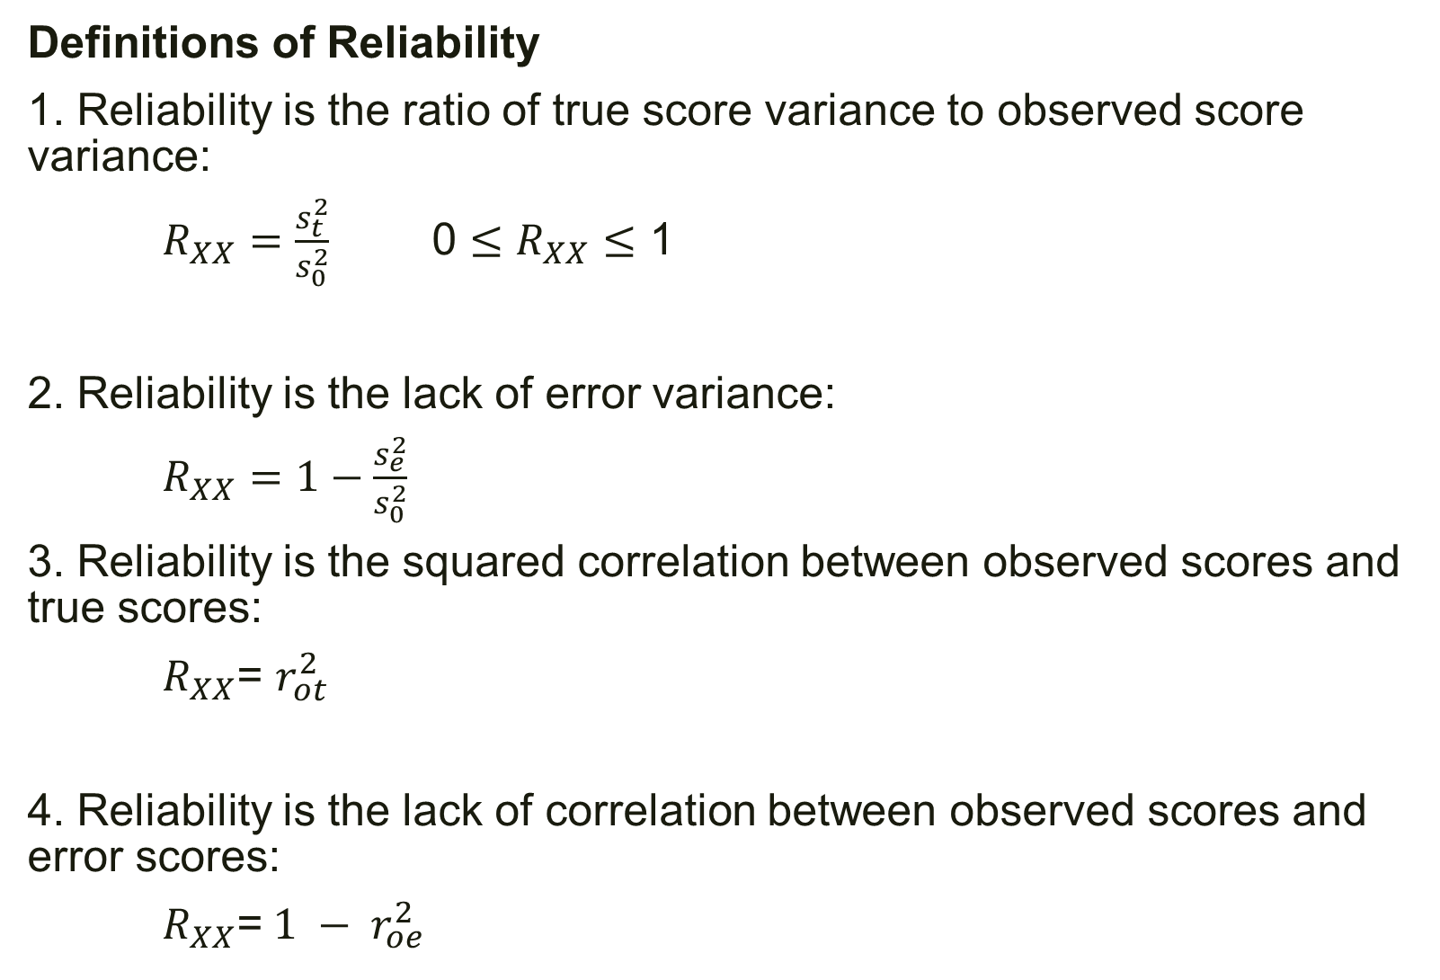
Definitions of Reliability
1. Reliability is the ratio of true score variance to observed score variance:
$R_{XX}=\frac{s_{t}^{2}}{s_{0}^{2}}$ 0 $≤$ $R_{XX}$ $≤$ 1
2. Reliability is the lack of error variance:
$R_{XX}=1−\frac{s_{e}^{2}}{s_{0}^{2}}$
3. Reliability is the squared correlation between observed scores and true scores:
$R_{XX}$= $r_{ot}^{2}$
4. Reliability is the lack of correlation between observed scores and error scores:
$R_{XX}$=${ 1 − r}_{oe}^{2}$

Slide 7
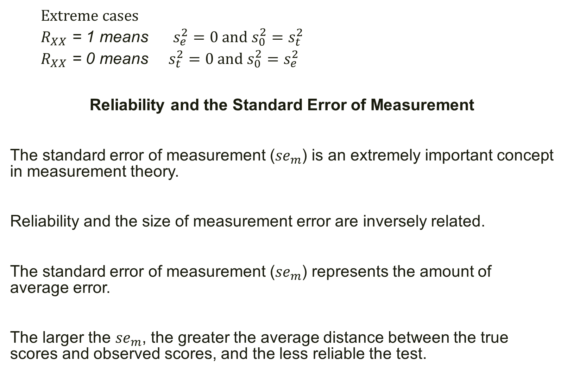
Extreme cases
$R_{XX}$ = 1 means $s_{e}^{2}=0 and s_{0}^{2}=s_{t}^{2}$
$R_{XX}$ = 0 means $s_{t}^{2}$ $=0 and s_{0}^{2}=$ $s_{e}^{2}$
Reliability and the Standard Error of Measurement
The standard error of measurement (${se}_{m}$) is an extremely important concept in measurement theory.
Reliability and the size of measurement error are inversely related.
The standard error of measurement (${se}_{m}$) represents the amount of average error.
The larger the ${se}_{m}$, the greater the average distance between the true scores and observed scores, and the less reliable the test.

Slide 8

The size of the measurement error.
${se}_{m}$ = $s_{0}\sqrt{1−R_{XX}}$; $s_{0}$ -- standard deviation of observed scores.
Example: Table 5.1
$s_{0}$=24.66,
reliability = .48,
${se}_{m}$=17.80

Slide 9
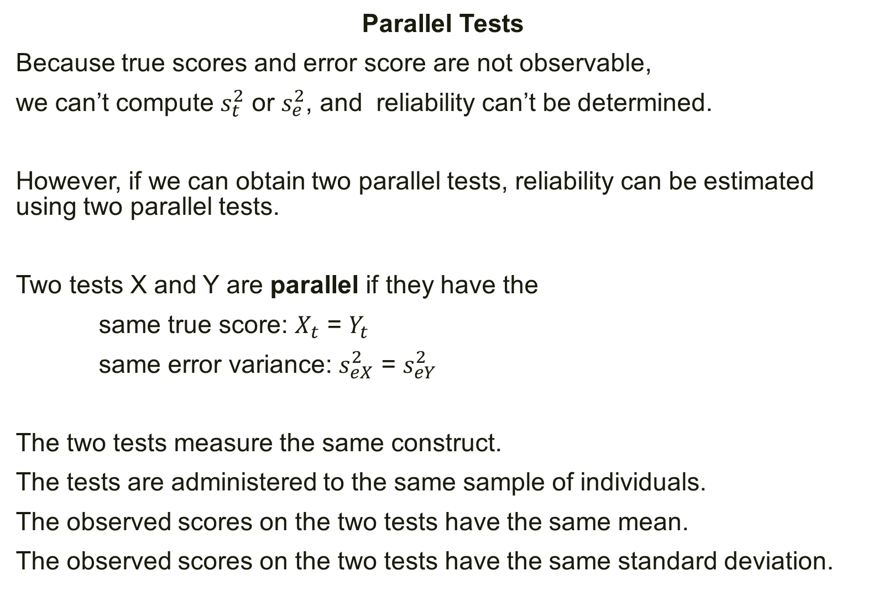
Parallel Tests
Because true scores and error score are not observable,
we can’t compute $s_{t}^{2}$ or $s_{e}^{2}$, and reliability can’t be determined.
However, if we can obtain two parallel tests, reliability can be estimated using two parallel tests.
Two tests X and Y are parallel if they have the
same true score: $X_{t}$ = $Y_{t}$
same error variance: $s_{eX}^{2}$ = $s_{eY}^{2}$
The two tests measure the same construct.
The tests are administered to the same sample of individuals.
The observed scores on the two tests have the same mean.
The observed scores on the two tests have the same standard deviation.

Slide 10

The correlation between parallel tests is equal to reliability.
That is, if two tests are parallel, then their correlation is equal to the reliability of both tests.
$R_{XX}$ = $r_{XY}$

